Slide 1

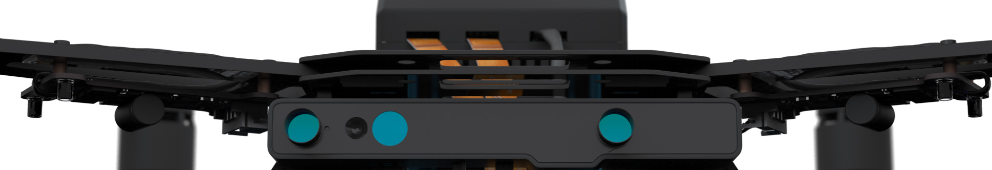
Autonomous Drone Engineer D3 – Docker Containers
Paul.Guermonprez@intel.com Autonomous Drone Solutions Architect

Slide 2
Software Partitioning

Slide 3
Production / Prototyping OSes
Intel Aero is shipped with a Yocto Linux build: Yocto is great as an embedded build system for professionals, including in the aeronautics sector where it is widely used.
But it is not very friendly for rapid prototyping: Some may prefer an OS like Ubuntu Linux https://www.ubuntu.com (© 2017 Canonical) or Debian.
How do we get the best of both worlds?

Slide 4
Client / Operator containment
Drone developers create flight stacks to operate the drone. It has to be validated, sometimes certified to make sure it’s safe to fly.
Drone clients may want to add their code to the drone. Their software payload can perform various tasks like image analysis during the flight and internet access. It does not have the same limitations as the flight code.
To speed up development and keep the drone safe to fly, it is better to keep the two software stacks separated.
We need a separation mechanism between the flight stack and the software payload

Slide 5
Docker on Intel Aero
There’s several possible mechanisms to create this separation and choice of OS for deployment. On Intel Aero we support containers.
A container is a set of resources (cpu, memory …) allocated to a set of processes. It’s a lot like a virtual machine but much lighter and efficient as it works at the process level and not the OS level.
It is very popular in the server world, where the toolbox Docker is allowing you to create development environments on your station (Linux, Mac, Windows) and migrate them to servers seamlessly.
To summarize, containers behave like a virtual machine but also like a way to package and deploy apps.

Slide 6
Working with containers

Slide 7
Typical usage
You choose an existing base image Ex: Ubuntu:16.04 Docker will download seamlessly if now available locally already
You launch, or instantiate this container Ex: docker run
You connect to the instance Ex: docker exec
You install packages, make changes to the OS …
You commit the changes to create a new image Ex: docker commit
Next time, you can instantiate this custom image Or you can move it to another machine for deployment
Containers are not Virtual Machines.

Slide 8
Network Architecture
Yocto OS running on Intel Aero acting as container engine
The container engine has direct network access and is acting as a router and DHCP server.
Containers have network access, but need to ask the container engine if they want to host servers. (it’s exactly like opening a port in your home router).
Ex: -p 2222:22 will forward port 2222 of the engine to port 22 of the container.
Wireless interface (wlp1s0) 192.168.0.13
|
Container Router
|
Virtual Interface (docker0) 172.17.0.1
Docker0 172.17.0.3
Debian Linux as a container
Docker0 172.17.0.2
Ubuntu Linux as a container

Slide 9
Example

Slide 10
Thanks
Paul.Guermonprez@intel.com

